Slide 1
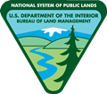
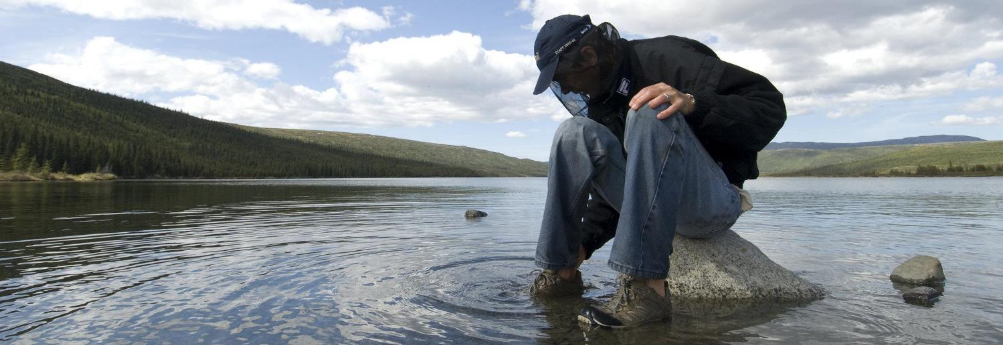
Watershed Management
U.S. Department of the Interior Bureau of Land Management
Module 5 Introduction
Photo by K. Miller, NPS.

Slide 2
Module 5: Watershed Management
U.S. Department of the Interior Bureau of Land Management
This module was developed in partnership with Alaska Pacific University and its Water Resources Management course.
Special thanks to Dr. Erin Larson, assistant professor of environmental science, and Kaitlan McLallen, undergraduate student in marine and environmental science. This work was supported by a NASA Alaska Space Grant award to Dr. Larson.

Slide 3
Module 5: Watershed Management Module Questions:
U.S. Department of the Interior Bureau of Land Management
What natural resources do you get from your local watershed?
What are the consequences of human modifications to watersheds?
How do communities balance the needs of people and the health of watersheds?

Slide 4
Materials:
U.S. Department of the Interior Bureau of Land Management
science journal or a piece of paper
something to write with

Slide 5
Natural Resources in Your Community
U.S. Department of the Interior Bureau of Land Management
Write down answers to the following questions in your science journal or on a piece of paper. If you don’t know the answers, ask a teacher, parent, or elder in your community.
What is the source of your community’s drinking water?
What is the source of your community’s electricity?
What is the source of your community’s heat?

Slide 6
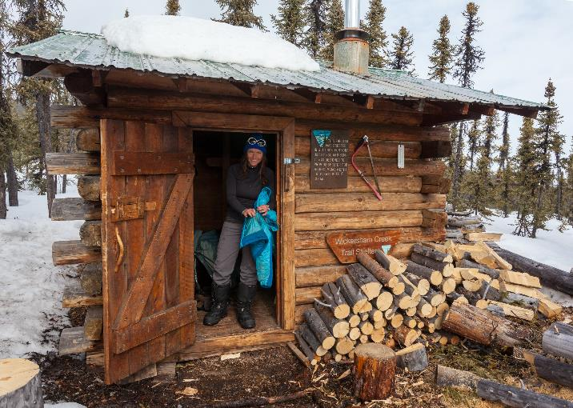
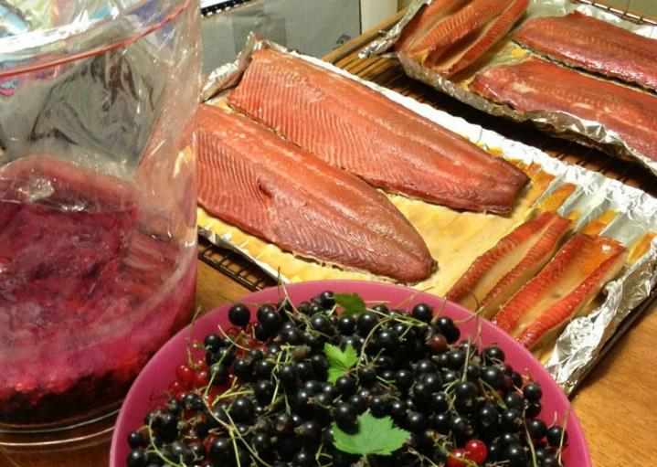
People get many things they need, such as water, food, materials, electricity, and fuel, from their watersheds. We call these things natural resources.
U.S. Department of the Interior Bureau of Land Management
Craig McCaa, BLM
USFWS

Slide 7
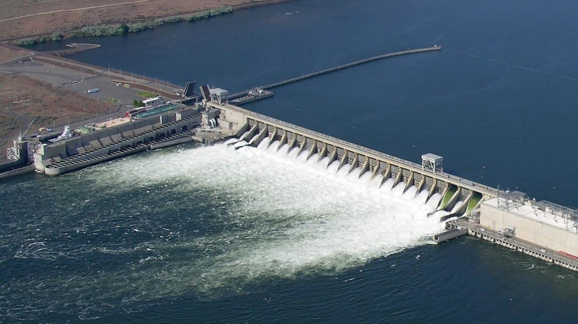
Humans often modify, or change, watersheds to get natural resources.
U.S. Department of the Interior Bureau of Land Management
The McNarry Dam in the state of Washington uses moving water to make electricity.
Army Corps of Engineers

Slide 8
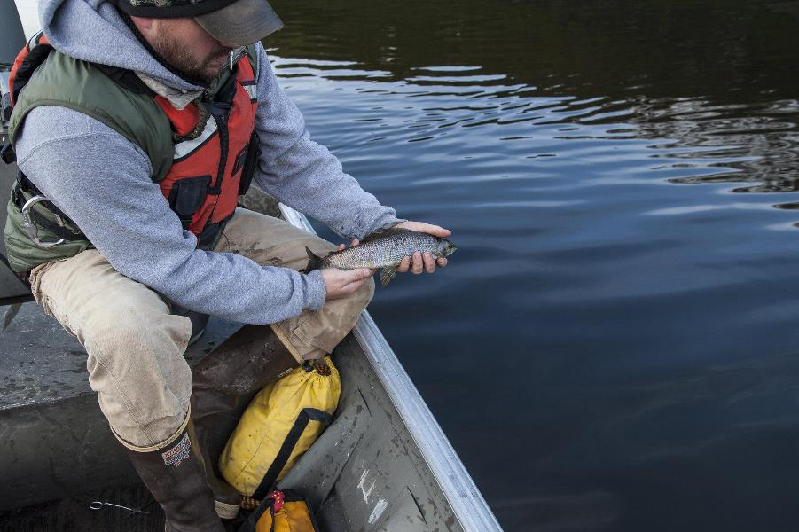
The changes that humans make to watersheds can affect the animals and plants that live in those watersheds.
U.S. Department of the Interior Bureau of Land Management
Bob Wick, BLM

Slide 9
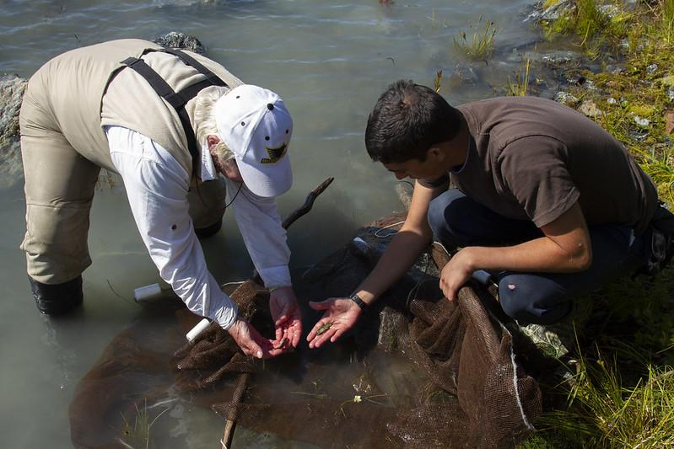
Land managers oversee natural resources. They balance the wants and needs of human communities and the health of watersheds.
U.S. Department of the Interior Bureau of Land Management
Chris Noyles, BLM

Slide 10
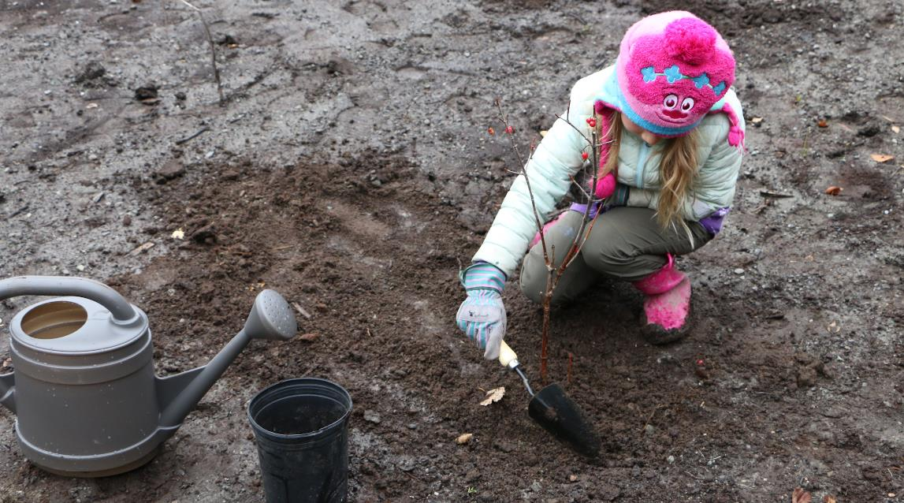
Everyone has a role in land management. The choices you make at home, in school, and in your community affect the watershed you live in.
U.S. Department of the Interior Bureau of Land Management
BLM

Slide 11
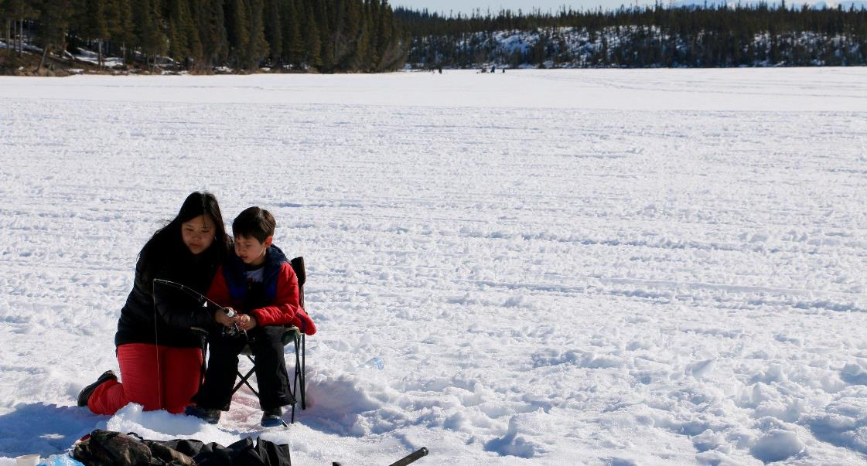
It is important to keep watersheds healthy. Healthy watersheds provide natural resources for all living things, including people.
U.S. Department of the Interior Bureau of Land Management
Robben Taylor, BLM

Slide 12
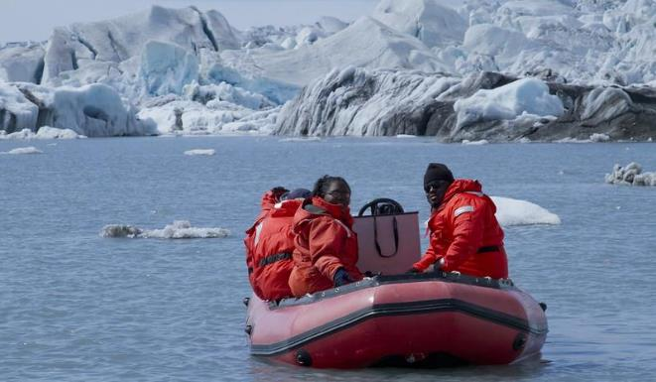
In this module, you will assume the role of a land manager. You will practice making decisions that balance the needs of communities and the health of watersheds.
U.S. Department of the Interior Bureau of Land Management
Chris Noyles, BLM

