Slide 1
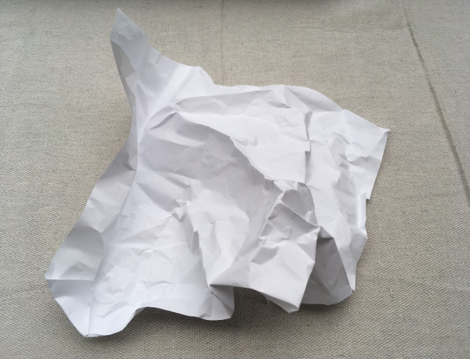
Paper Watershed Model
U.S. Department of the Interior Bureau of Land Management
Crumple paper to create your own watershed model.
Module 1, Lesson 1
A crumpled piece of white paper.
Photo by CCSC staff, BLM.

Slide 2
Lesson 1: Paper Watershed Model
Lesson Question:
U.S. Department of the Interior Bureau of Land Management
How does water move through a landscape?

Slide 3
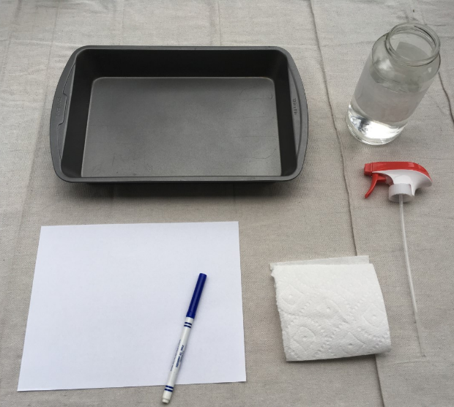
Materials
U.S. Department of the Interior Bureau of Land Management
one piece of paper
one washable marker
spray bottle or glass of water
cookie sheet or pan to catch water
paper towel or rag for clean up
A collection of supplies needed for the watershed activity.
Photo by CCSC staff, BLM.

Slide 4
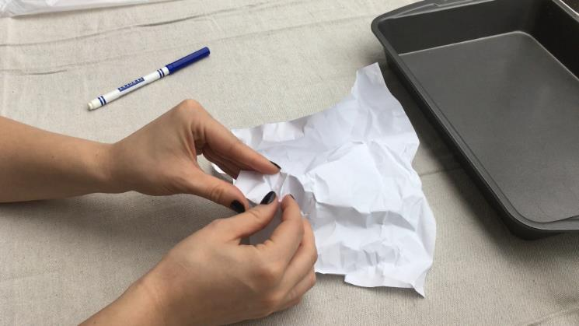
U.S. Department of the Interior Bureau of Land Management
Follow the steps to create a watershed model.
Step 1: Crumple a piece of paper into a loose wad. Then, uncrumple the paper without flattening it.
Use your fingers to emphasize some of the peaks. A peak is the top of a mountain.
A person crumples a piece of white paper to create a watershed model. Photo by CCSC staff, BLM.

Slide 5
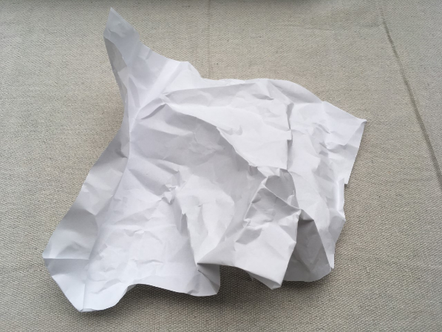
U.S. Department of the Interior Bureau of Land Management
Step 2: Inspect your landscape. A landscape is all the features of an area of land, such as hills, rivers, trees, and buildings. Imagine you are flying over in an airplane.
Can you find the tallest mountain and the deepest valley? A valley is the low point between mountains or hills.
Notice the details of the shape of your landscape.
A crumpled piece of white paper.
Photo by CCSC staff, BLM.

Slide 6
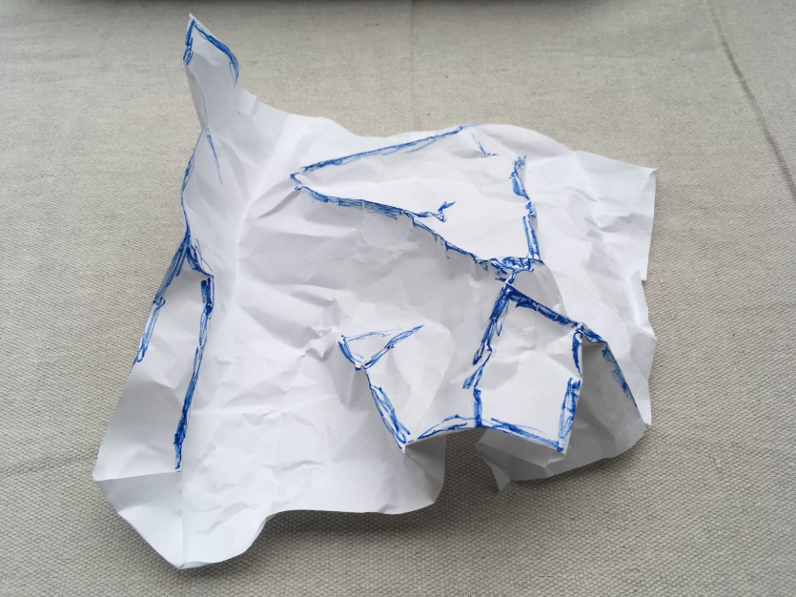
Step 3: Use a marker to carefully trace the ridges and high points of your landscape. A ridge is a long, narrow high point of land that extends from a peak.
U.S. Department of the Interior Bureau of Land Management
A crumpled piece of paper with the high ridges colored in blue. Photo by CCSC staff, BLM.

Slide 7
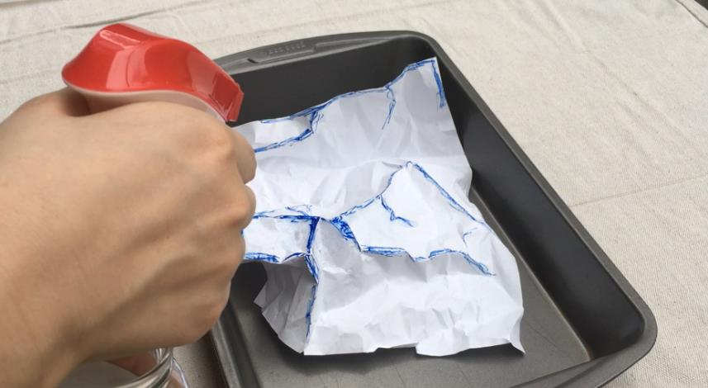
Step 4: Set your colored landscape on a cookie sheet, pan, or other surface that can catch water. Use a spray bottle or your fingers and a glass of water to mimic rain falling on the landscape.
U.S. Department of the Interior Bureau of Land Management
A person holds a spray bottle over a crumpled piece of paper with the ridges highlighted in blue. Photo by CCSC staff, BLM.

Slide 8
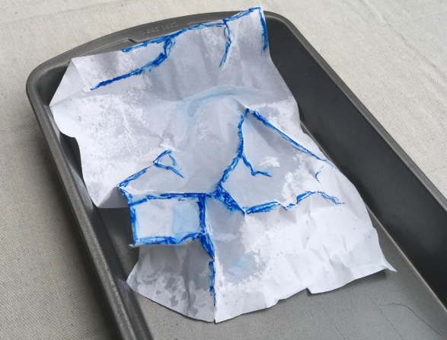
U.S. Department of the Interior Bureau of Land Management
Step 5: Take a few minutes to observe your landscape. Add more rainwater if you would like. What do you notice about where the water goes on the model? Where did it flow down? Where did it pool and form lakes? Identify different features in your model.
A crumpled piece of paper with ridges highlighted in blue sits in a deep-dish pan to catch the dripping water. Photo by CCSC staff, BLM.

Slide 9
Were you able to identify all four features labeled in the image below? Did you find any different landforms or water bodies in your model?
U.S. Department of the Interior Bureau of Land Management
river
lake
watershed
watershed
A crumpled piece of paper with ridges highlighted in blue sits in a deep-dish pan to catch the dripping water. Photo by CCSC staff, BLM.

